Slide 1

Introduction to Node.js
Overview, Modules, Web Server, Request and Response
SoftUni Team
Technical Trainers
Software University
http://softuni.bg

Slide 2
Table of Contents
Introduction to Node.js
Event Loop
Modules
Request and Response Wrapper
Node.js Web Server

Slide 3
Have a Question?
sli.do #js-web

Slide 4

Introduction to Node.js
Overview, Installation, Configuration

Slide 5
Node.js Overview
A runtime environment for JS that runs on the server
Advantages:
One language for server and client
Asynchronous and Event Driven
Very fast
Efficient package manager
No buffering

Slide 6
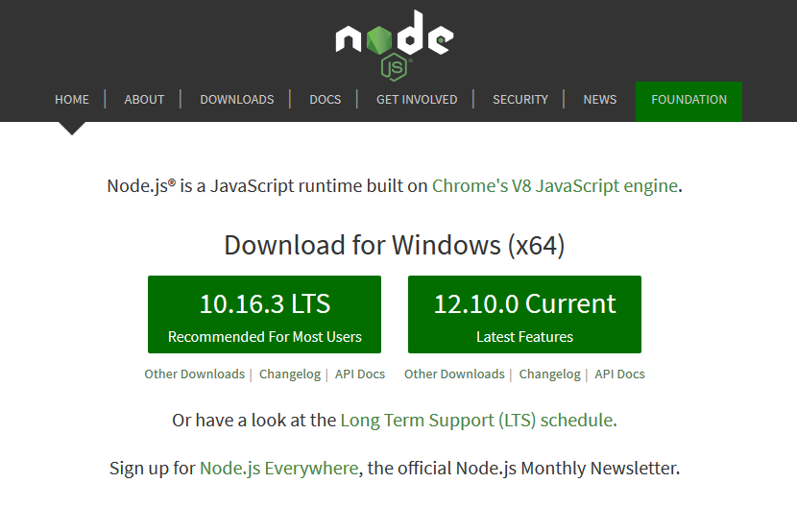
Installation
Go to http://nodejs.org and install the latest version
To check the currently installed version of node, type in the command prompt / terminal:
node -v

Slide 7

Environment Setup
From the terminal
Interpret code from a file
Save script to index.js
Execute from the terminal:
node // Starts REPL
let a = 5
let b = 3
a + b // 8
node index.js

Slide 8
NPM Packages
Node.js projects are usually set up as NPM packages
From the terminal, inside the target directory:
Answer questions to initialize project
A package.json file will be created with initial configuration
To bypass all questions (take default values):
npm init
npm init -y

Slide 9
Configuration (package.json)
{
"name": "demo",
"version": "1.0.0",
"description": "Node.js demo project",
"main": "index.js",
"engines": { // Sets versions of Node.js
"node": ">= 6.0.0", and other commands
"npm": ">= 3.0.0" },
"scripts": { // Defines a set of node scripts
"start": "node index.js" },
"keywords": [],
"author": "",
"license": "ISC“
}

Slide 10

Event Loop
Event-Driven Programming

Slide 11


The Event Loop
Long-running processes
Order of completion
is not guaranteed

Slide 12
Stack Execution
The Stack
The Heap
function

Slide 13
Stack Execution
The Stack
The Heap
function
function
function
Function call
Execution returns

Slide 14
Stack Execution
The Stack
The Heap
Program finished

Slide 15
The Event Loop
The Stack
The Heap
function
function
function
Event Queue
event
Event placed in the queue

Slide 16
The Event Loop
The Stack
The Heap
function
Execution stack
is empty
function
function
Event Queue
event

Slide 17
The Event Loop
The Stack
The Heap
Event callback is executed
function
Event Queue
event

Slide 18

Modules
Making Modular App

Slide 19
Modules
Allow larger apps to be split and organized
Each module has its own context
It cannot pollute the global scope
Node.js includes three types of modules:
Core Modules
Local Modules
Third Party Modules

Slide 20
Local Modules
Created locally in the Node.js application
Include different functionalities in separate folders
Use module.exports to expose a function, object or variable
Loaded using the require() function
module.exports = myModule
const myModule = require('./myModule.js');

Slide 21
Third-Party Modules
Installed from Node Package Manager (NPM)
Run from the terminal
To use in your code
To install globally (for use from the terminal)
npm install --save express --save-exact
const express = require('express');
npm install --g mocha
21

Slide 22
Core Modules
Include bare minimum functionalities of Node.js
Load automatically when Node.js process starts
Need to be imported in order to be used
Commonly used modules are:
http - used to create Node.js server
url, querystring, path, fs
const module = require('module');

Slide 23
URL Module
Provides utilities for URL resolution and parsing
Parses an address with the parse() function
Returns an object with info about the url
Splits web address into readable parts
const url = require('url');
let urlObj = url.parse(req.url);

Slide 24
URL Parts
Host 'localhost:8080'
Path '/home'
Search/query '?year=2017&month=february'
let host = urlObj.host
let path = urlObj.pathname
let query = urlObj.query
let search = urlObj.search

Slide 25
Query String Module
Provides utilities for parsing and formatting URL query strings
Parses a query string into an object
const queryString = require('querystring');
const qs = querystring
.parse('year=2017&month=february');
const year = qs.year; // 2017
const month = qs.month; // february

Slide 26

Node.js Web Server
Introduction to Web Servers

Slide 27
Web Servers
All physical servers have hardware
The hardware is controlled by the operating system
Web servers are software products that use the operating system to handle web requests
Web servers serve Web content
The requests are redirected to other software products (ASP.NET, PHP, etc.), depending on the web server settings

Slide 28
Node.js Web Server
Creating a simple Node.js web server
const http = require('http');
http.createServer((req, res) => {
res.write('Hi!');
res.end();
}).listen(1337);
console.log('Node.js server running on port 1337');

Slide 29

Request & Response Wrappers
Handling Requests and Responses

Slide 30
The Request Wrapper
Used to handle incoming http requests
Properties:
httpVersion - '1.1' or '1.0'
headers - object for request headers
method - 'GET', 'POST', etc.
url - the URL of the request

Slide 31
Request Wrapper Example
const http = require('http');
const url = require('url');
const port = 1337;
http.createServer((req, res) => {
let path = url.parse(req['url']).pathname;
if (path === '/') {
// TODO: Send 'Welcome to home page!'
}
}).listen(port);

Slide 32
The Response Wrapper
Used to retrieve a response to the client
Functions:
Create response header
Send the actual content to the client
End the response

Slide 33
Response Wrapper Example
const http = require('http');
const port = 3000;
http.createServer((req, res) => {
res.writeHead(200, { // Response Status Code
'Content-Type': 'text/plain'
});
res.write('Hello from Node.js'); // UTF-8 Encoding
res.end(); // Always End the Response
}).listen(port);

Slide 34

Live Exercises

Slide 35

Summary
…
…
…
Node.js is a fast and asynchronous efficient package manager
Applications can be organized using module
NPM allows quick access to external modules
Web Servers transfer resources to the Client
The Request/Response Wrappers

Slide 36
https://softuni.bg/trainings/2452/js-back-end-september-2019

Slide 37












SoftUni Diamond Partners

Slide 38




SoftUni Organizational Partners

Slide 39




Trainings @ Software University (SoftUni)
Software University - High-Quality Education and Employment Opportunities
softuni.bg
Software University Foundation
http://softuni.foundation/
Software University @ Facebook
facebook.com/SoftwareUniversity
Software University Forums
forum.softuni.bg

Slide 40

License
This course (slides, examples, demos, videos, homework, etc.) is licensed under the "Creative Commons Attribution-NonCommercial-ShareAlike 4.0 International" license

